Slide 1
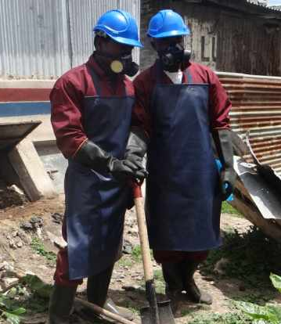

Water Sector Trust Fund
Personal Protective Equipment (PPE)
Version:2.0
Last Update: August 2017

Slide 2

Don’t get sick!
You should always wear the recommended protective equipments when emptying the toilet to ensure your own personal safety
The protective equipment protects you from the germs present in human excreta.
When choosing the protective equipment , durability, comfort and meet the public health needs should be purchased

Slide 3
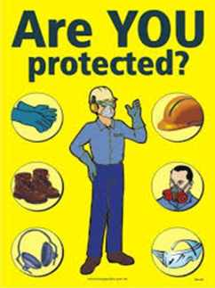
Protective Equipment Checklist
Whenever you report to empty a toilet, ensure you have the following!
Overalls
Apron
Helmet
Respirator
Gloves

Slide 4
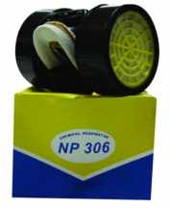
Protective Equipment Checklist
A respirator prevents you from inhaling any germs in the air
Notes:
Easy language

Slide 5
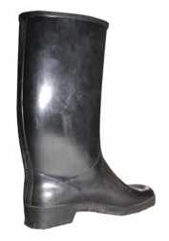
Gumboots
Gumboots protect your feet from urine, faeces, broken glass or metal.

Slide 6

Helmet
A helmet protects your head. Please remember that you are emptying vaults!
Always wear it when you are at work

Slide 7

Gloves
Gloves protect your hands! You should not come into any direct contact with the faeces or any contaminated solid waste such as broken glass or metals!
Notes:
Simple language

Slide 8
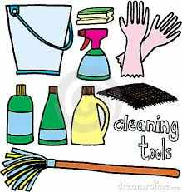
Cleaning
The tools and equipment that are used should be disinfected (e.g. Jik) rinsed, thoroughly dried and stored.
After emptying, make sure you wash your hands thoroughly with soap and water
Notes:
Area of storage should be designated in the treatment plant (one of the best methods of monitoring the manual emptiers are wearing their PPEs and dumping in the DTFs)
First aid kits should be stored with the operator of the DTF.

Slide 9

Cleaning
Area of storage should be designated in the treatment plant
The protective equipment should be used for the purpose of waste collection and emptying.
Ensure you have a first-aid kit in case of any injuries
Notes:
Area of storage should be designated in the treatment plant if possible (one of the best methods of monitoring the manual emptiers are wearing their PPEs and dumping in the DTFs)
First aid kits should be stored with the operator of the DTF.

Slide 10

Thank you
Notes:
Area of storage should be designated in the treatment plant if possible (one of the best methods of monitoring the manual emptiers are wearing their PPEs and dumping in the DTFs)
First aid kits should be stored with the operator of the DTF.

